Slide 1
Multi-motion
By – Allan Thomas

Slide 2
What is this project about?
It primarily focuses on heart rate variability (HRV) to explore emotional arousal and stress levels, by interpreting data from various physiological sensors, including heart rate, galvanic skin response (GSR), pupil size, and facial recognition. The research is propelled by the goal to integrate these physiological measure to predict valence and arousal accurately, enhancing the precision of emotion recognition in the field of Artificial emotional recognition (AEI).

Slide 3
What is HRV (Heart Rate Variability)?
HRV is about how much the time between your heartbeats varies. It's not about how fast your heart beats, but about the tiny changes in time between each beat. Imagine your heart as a drummer: rather than drumming at a constant, unchanging speed, it changes the rhythm slightly with each beat.

Slide 4
How HRV matters?
Connection to Emotions and Stress: When you're feeling calm and relaxed, your heartbeat varies more – it's like the drummer is playing a bit more freely. This is a higher HRV and is generally a good sign, indicating that your body can adapt to changes easily.
What Happens Under Stress: Now, when you're stressed or under pressure – like when you're anxious or facing a tight deadline – your HRV decreases. This means the time between each heartbeat becomes more consistent and less varied. The drummer is now playing a more steady, unchanging rhythm. A lower HRV in such situations shows that your body is in a more alert, stress mode.
Why It Matters: The reason HRV is important is that it tells us about how our body is handling stress. A high HRV (more variability) suggests that you are more relaxed and can handle stress better. A low HRV (less variability) can be a sign that you're under stress or not coping as well with it.
In short, HRV is a way of understanding how our body responds to stress and relaxation. It's like a natural stress meter, showing us how our heart adjusts its rhythm in different emotional states.

Slide 5
How is HRV associated with Arousal ?
Overall HRV can be said to be an indicator of physiological stress or arousal, with
Increased arousal associated with a low HRV, and a decreased arousal associated with high HRV.
Using ECG alongside other measurements therefore provides another way to investigate ow people respond to different settings or stimuli.

Slide 6
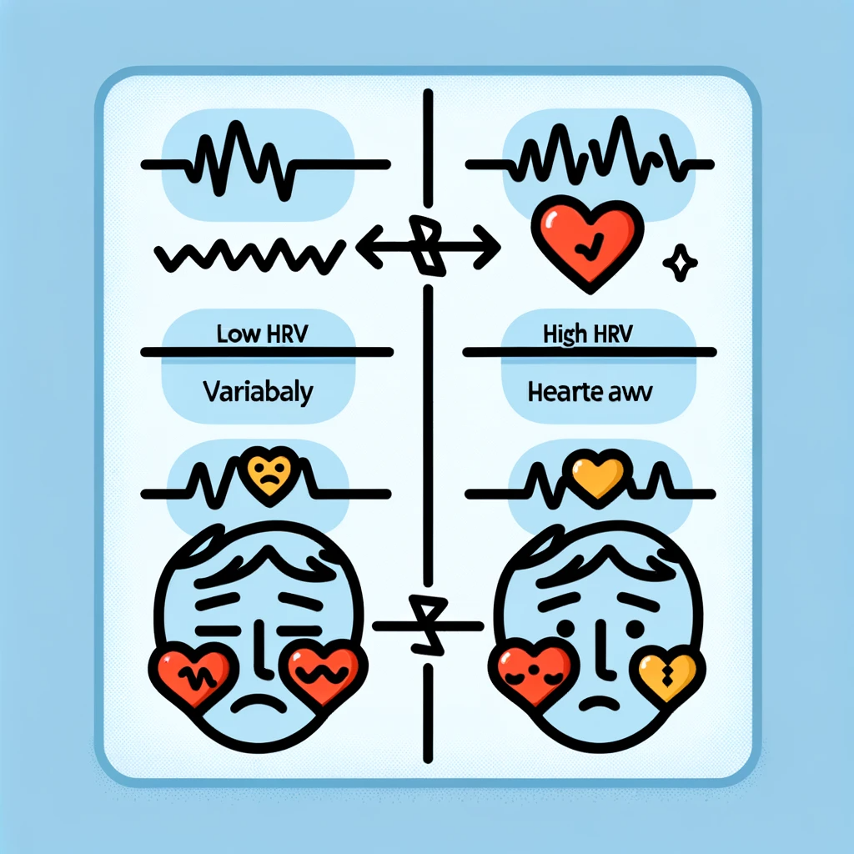
Low HRV vs High HRV
Here is a simple educational diagram that illustrates the concept of Heart Rate Variability (HRV) and its relationship to arousal. The diagram contrasts 'Low HRV' with increased arousal (like stress or alertness) and 'High HRV' with decreased arousal (like calmness or relaxation), along with heart icons to represent the variable and consistent heartbeat lines. This visual should help in understanding the relationship between HRV and emotional states.

Slide 7
The main features associated with HRV
Heart Rate (HR)
Inter-Beat Interval (IBI)

Slide 8

What is Heart Rate (HR) ?
Heart rate (HR) is the count of how many times your heart beats in a minute, usually expressed in beats per minute (bpm).
It's like a speedometer for your heart, showing how fast it's beating. To measure HR, an ECG (electrocardiogram) is used, which detects the heart's electrical activity through sensors placed on the skin.

Slide 9
Inter-beat Interval (IBI)
The IBI is the time interval between individual beats of the
heart, generally measured in units of milliseconds (ms).
Typically, the RR-interval is used for the analysis.
Before we learn to calculate the RR-interval we need to learn about the QRS complex.

Slide 10
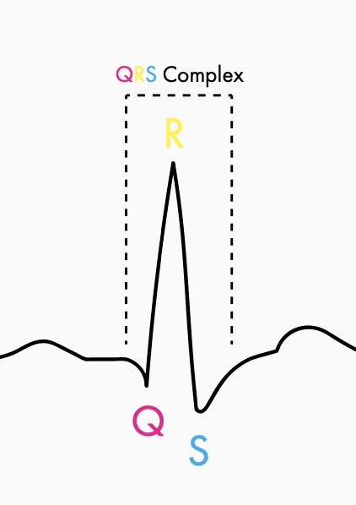
What is the QRS complex ?
The image to the left shows a prototypical heartbeat.
This is known as the QRS complex, with each letter corresponding to a different part of the heart’s action.
The important thing to note is that the “R” of the complex is the area from which the values for analysis are taken.
When we have several heartbeats next to each other, then the distance (in milliseconds) between each “R” is defined as the “RR interval” (or sometimes the “NN interval” to emphasize that the heartbeats are normal).

Slide 11
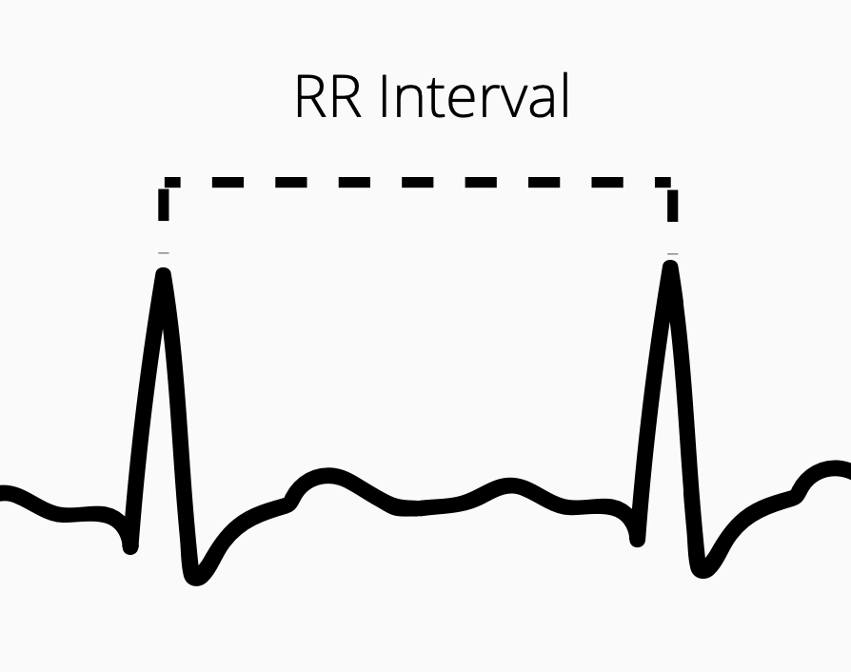
What is the RR interval?
When we have several heartbeats next to each other, then the distance (in milliseconds) between each “R” is defined as the “RR interval” (or sometimes the “NN interval” to emphasize that the heartbeats are normal).

Slide 12
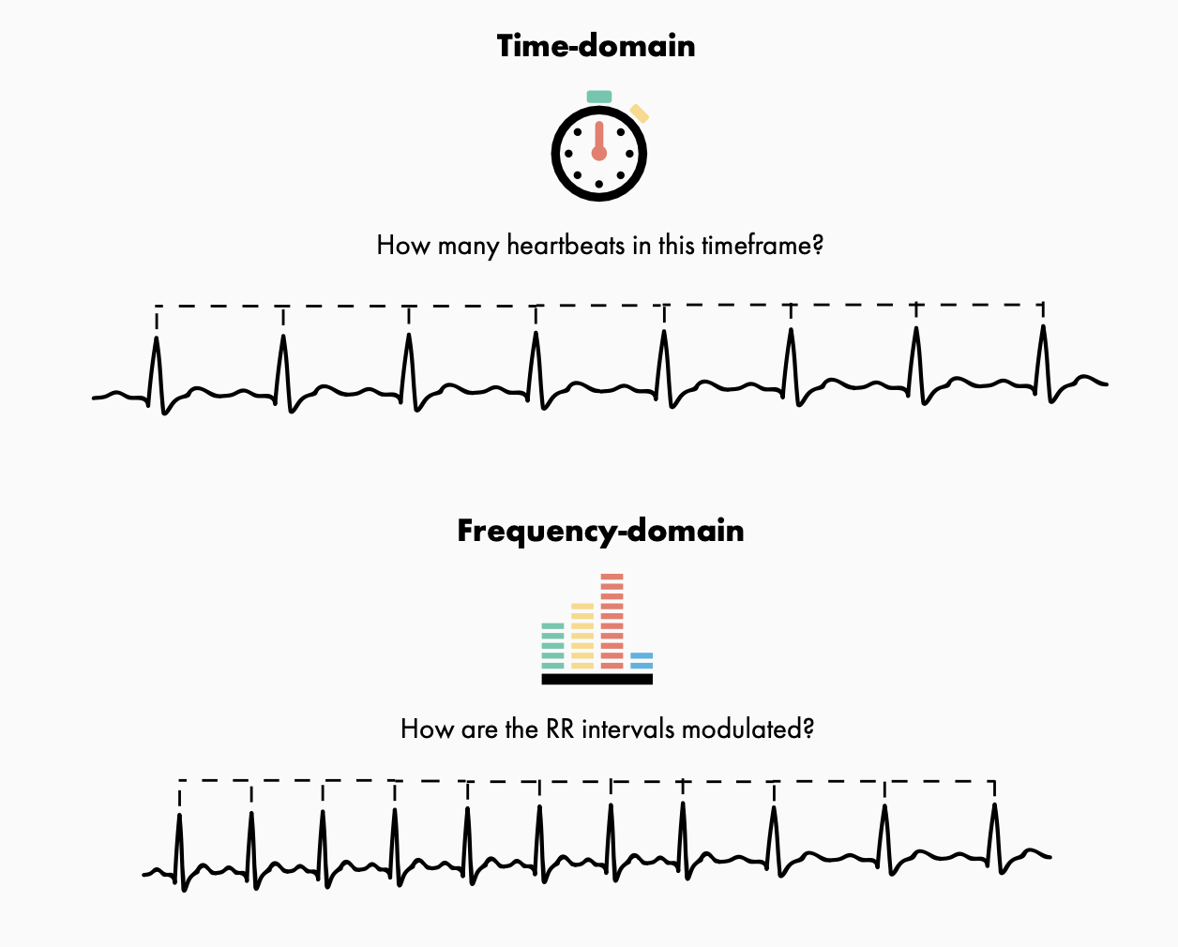
How to calculate HRV?
One of the main divisions for the way in which HRV is calculated is by either using time or frequency.
In this context, time-domain methods mean that the beat-to-beat amount within an amount of time is used, while frequency-domain methods count the amount of low and high frequency beats that occur.
This is explained further in the image.

